Slide 1
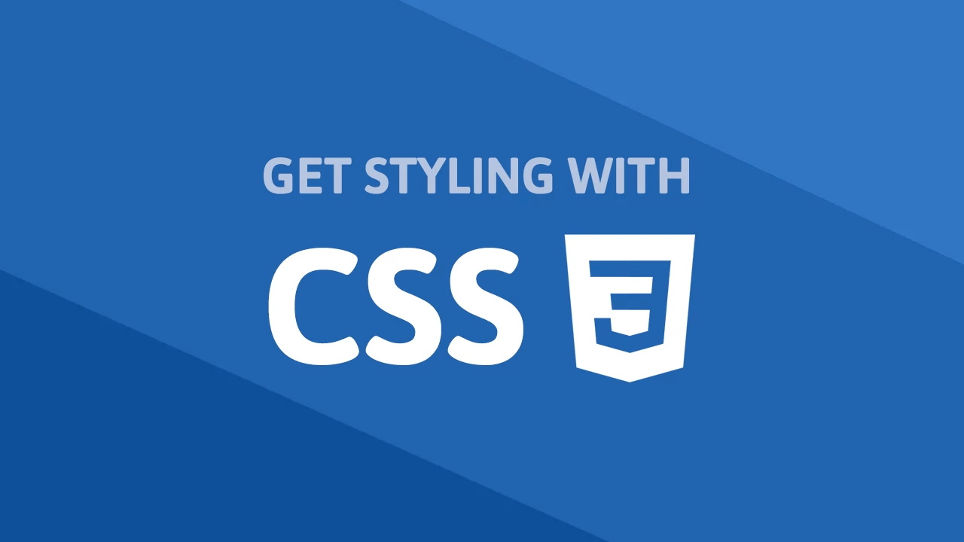

Slide 2
What is CSS?
CSS stands for Cascading Style Sheets.
It is a style sheet language which is used to describe the look and formatting of a document written in markup language.
It is generally used with HTML to change the style of web pages and user interfaces.

Slide 3
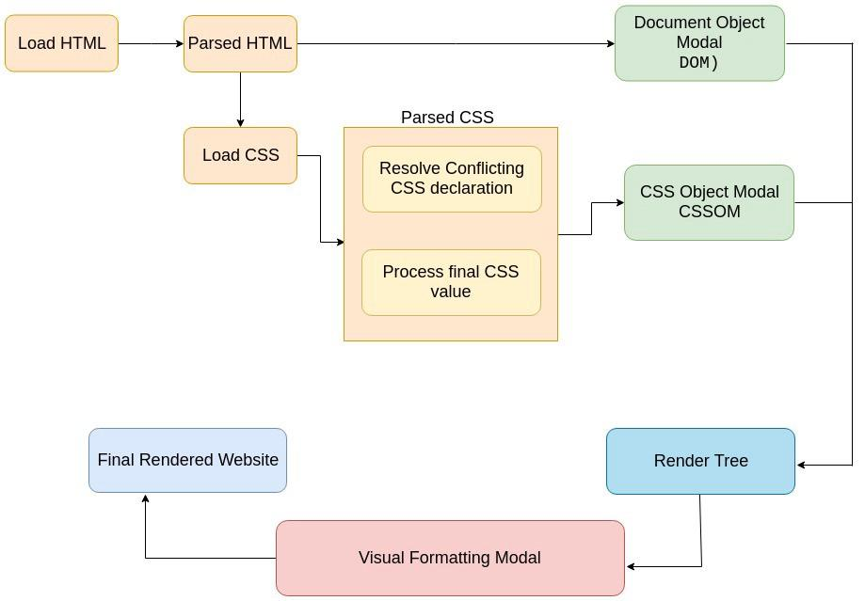
How CSS works?

Slide 4
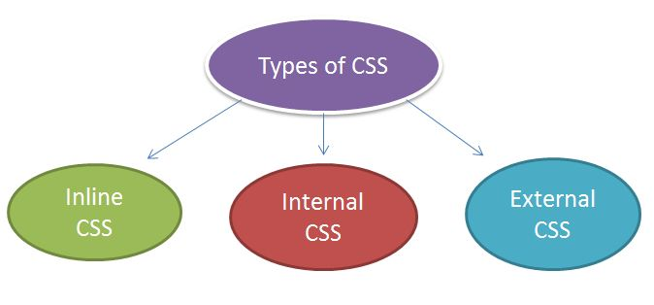
Types of CSS

Slide 5
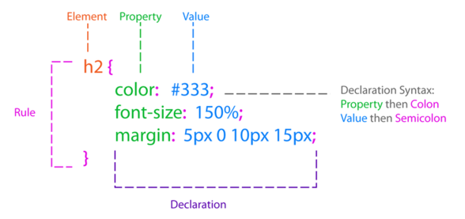
Syntax
A CSS rule set contains a selector and a declaration block.

Slide 6
Selector
Selectors are the part of CSS rule set.
They are used to select the content you want to style.
CSS selectors are used to "find" (or select) the HTML elements you want to style.
CSS selectors select HTML elements according to its id, class, type, attribute etc.

Slide 7
Selectors Categories
Simple selectors - select elements based on name, id, class
Combinator selectors - select elements based on a specific relationship between them
Pseudo-class selectors - select elements based on a certain state
Pseudo-elements selectors - select and style a part of an element
Attribute selectors - select elements based on an attribute or attribute value

Slide 8
Simple Selector
Element Selector
The element selector selects the HTML element by name.
ID Selector
The id selector selects the id attribute of an HTML element to select a specific element
Class Selector
To select elements with a specific class, write a period (.) character

Slide 9
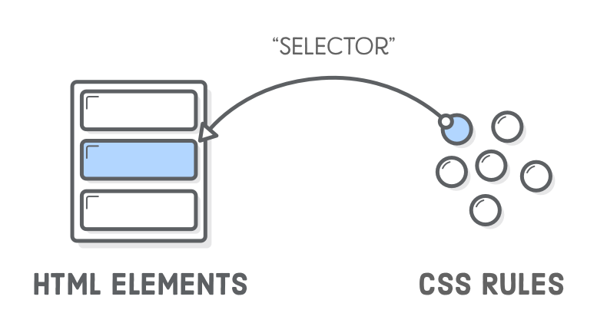
How Selector Works?

Slide 10
CSS Fonts
1. Font Families
To change the font family ex,
font-family: Courier (any font family name)
2. Font Style
To change the font style
ex, font-style: italic (3 property - normal,italic,oblique)
3. Font Size
To change the size of font
ex, font-size: 30px (number of pixel value)

Slide 11
CSS Color
To change the color of text or container
The colors can be specified in different ways
Color name - red, green
RGB value - rgb(255,0,0), rgb(0,0,255)
Hexadecimal value - #FF0000, #0000FF
ex, color : red (value of color in any one format)

Slide 12
CSS Backgrounds
It used to define the background effects for elements
Two types of background effects
Background Color
It add background color of an element
ex, background-color : red (value of color in any one format)
Background Image
It add background image of an element
ex, background-image: url("**") (image location or image url)

Slide 13
CSS Height and Width
- It is used to set the height and width of an element
- example,
height: 200px (number of pixel value)
width: 50px (number of pixel value)

Slide 14
Simple Selector - Continue
Universal Selector
The universal selector is used as a wildcard character (*). It selects all the elements on the pages.
Group Selector
The grouping selector is used to select all the elements with the same style definitions.Grouping selector is used to minimize the code.Commas are used to separate each selector in grouping.

Slide 15
Combinator Selector
Descendant Selector (space)
The descendant selector matches all elements that are descendants of a specified element.
Child selector (>)
The child selector selects all elements that are the children of a specified element.

Slide 16
Combinator Selector
Adjacent Sibling Selector (+)
The adjacent sibling selector selects all elements that are the adjacent siblings of a specified element.
Sibling elements must have the same parent element, and "adjacent ”
General Sibling Selector (~)
The general sibling selector selects all elements that are siblings of a specified element.

Slide 17
Pseudo-classes Selector
A pseudo-class is used to define a special state of an element.
It can be used to:
To style an element when a user mouses over it
To style visited and unvisited links differently
To style an element when it gets focus
selector:pseudo-class {
property:value;
}

Slide 18
Pseudo-elements Selector
A pseudo-element is used to style specified parts of an element.
It can be used to:
Style the first letter, or line, of an element
Insert content before, or after, the content of an element
selector::pseudo-element {
property:value;
}

Slide 19
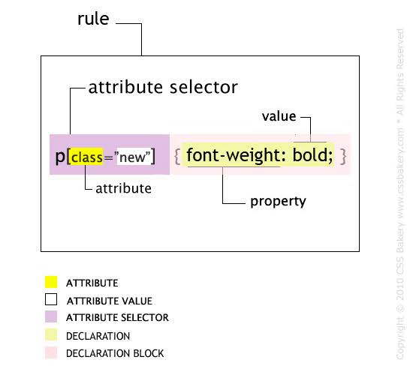
Attribute Selectors
To style HTML elements that have specific attributes or attribute values.

Slide 20
Display
It specifies how the element is displayed.
Every element on the web page is a rectangular box and the CSS property defines the behavior of that rectangular box.
Types of display property
Display inline
Display inline-block
Display block
Display none

Slide 21
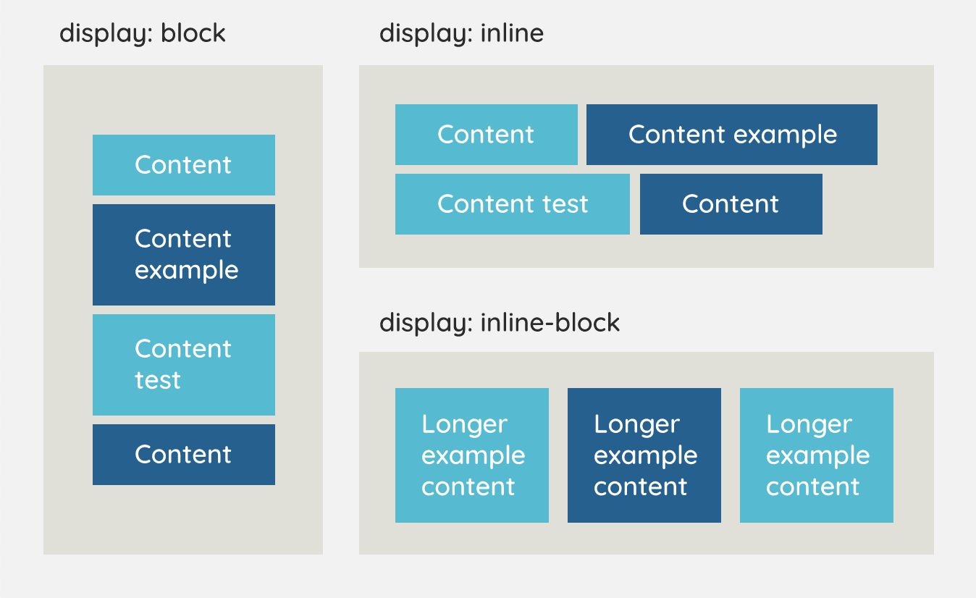
Display - Continue

Slide 22
Types of Display
Display inline
The inline element takes the required width only. It doesn't force the line break so the flow of text doesn't break in inline
Display inline-block
The CSS display inline-block element is very similar to inline element but the difference is that you are able to set the width and height.
Display block
The CSS display block element takes as much as horizontal space as they can. Means the block element takes the full available width. They make a line break before and after them.
Display none
The "none" value totally removes the element from the page. It will not take any space.

Slide 23
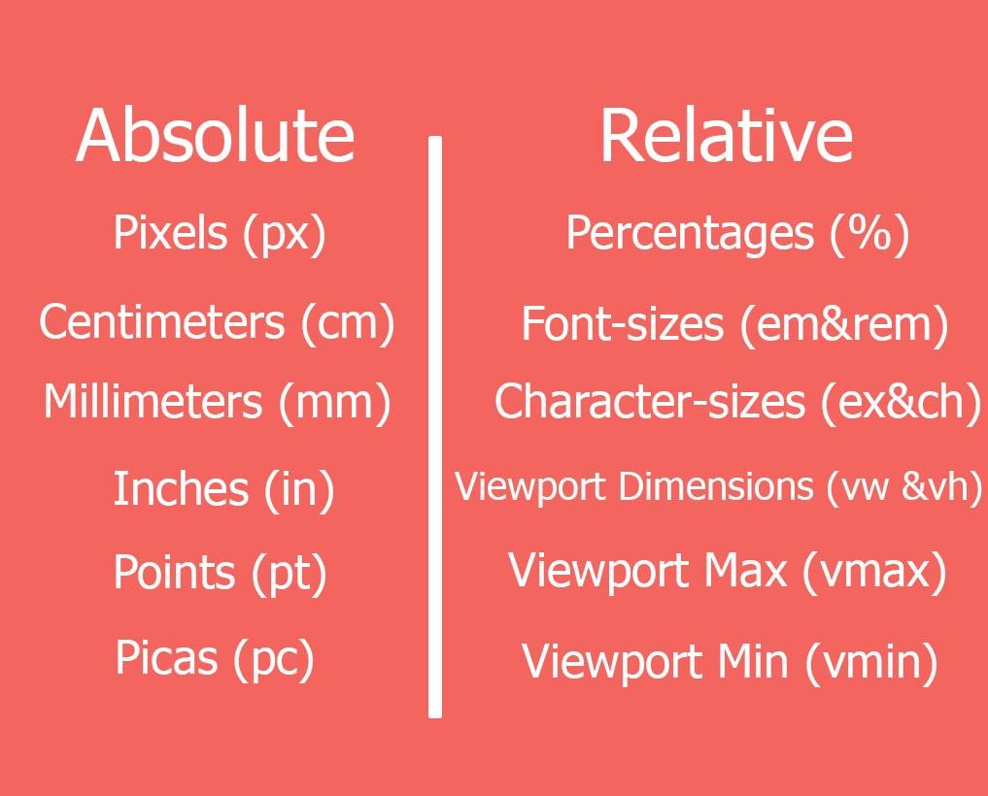
Units
Absolute Lengths
The absolute length units are fixed and a length expressed in any of these will appear as exactly that size.
Relative Lengths
Relative length units specify a length relative to another length property.

Slide 24
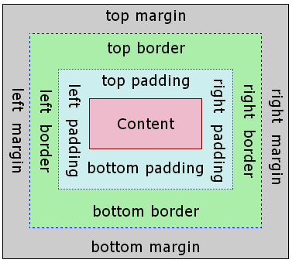
Box Model
All HTML elements can be considered as boxes.
It consists of margins, borders, padding, and the actual content.

Slide 25
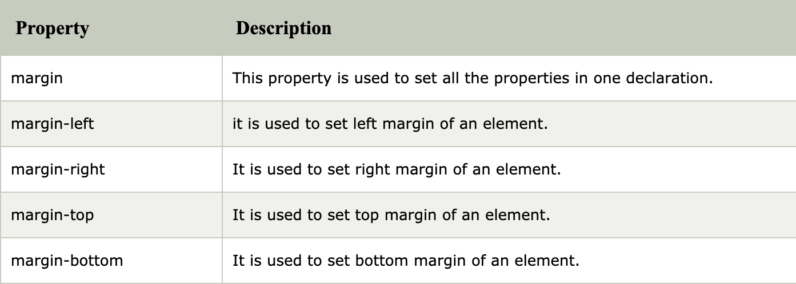
Margin
It is used to define the space around elements
It is completely transparent and doesn't have any background color

Slide 26
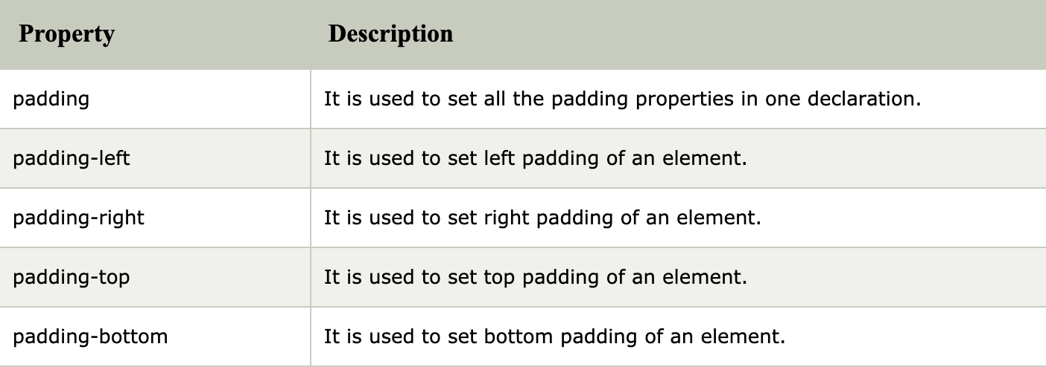
Padding
It is used to define the space between the element content and the element border.
It is different from CSS margin in the way that CSS margin defines the space around elements

Slide 27
Border
It is a shorthand property used to set the border on an element.
The border properties are use to specify the style, color and size of the border of an element
Border Style - The Border style property is used to specify the border type which you want to display on the web page
Border Color - There are three methods to set the color of the border. (Name, RGB, Hex)
Border Width - The border-width property is used to set the border's width.

Slide 28
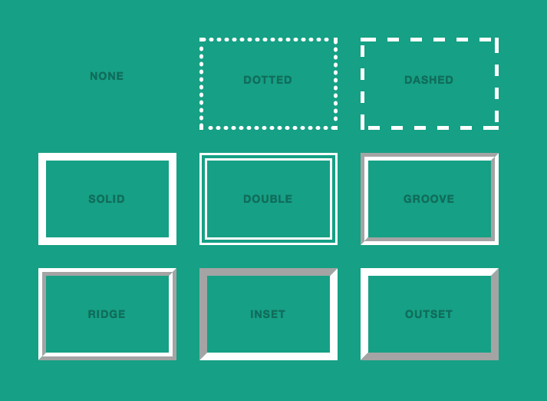
Border Style

Slide 29
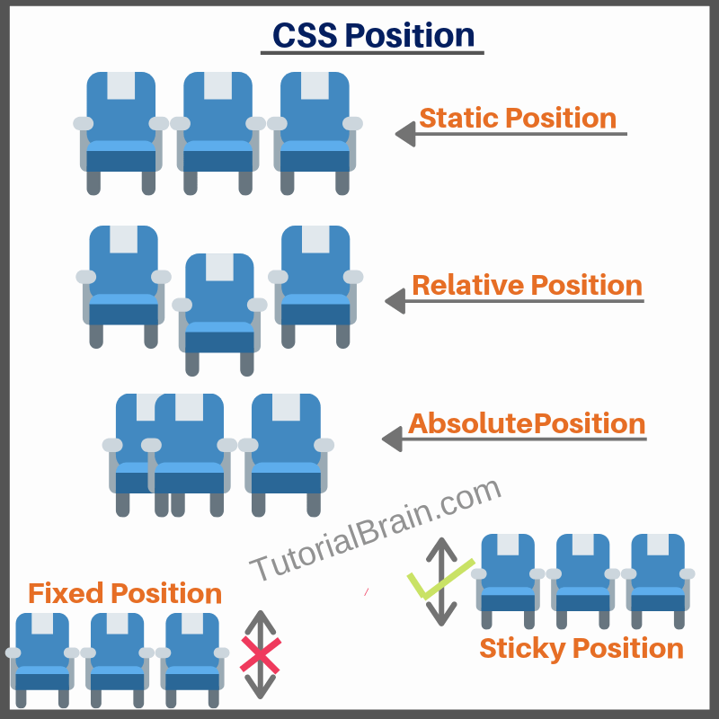
Position
The CSS position property is used to set position for an element.
It is also used to place an element behind another and also useful for scripted animation effect.

Slide 30
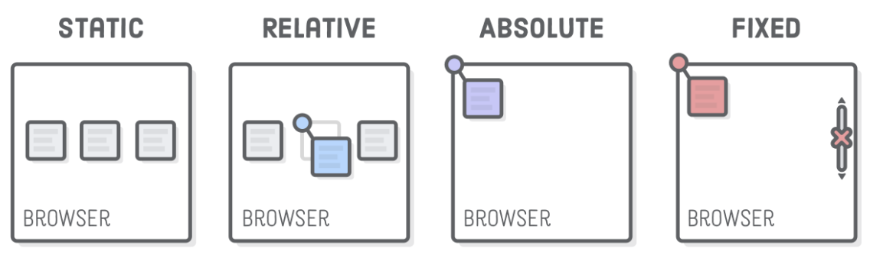
Types of Position

Slide 31
Position Static
This is a by default position for HTML elements.
It always positions an element according to the normal flow of the page.
It is not affected by the top, bottom, left and right properties.

Slide 32
Position Relative
The relative positioning property is used to set the element relative to its normal position.
Setting the top, right, bottom, and left properties of a relatively-positioned element will cause it to be adjusted away from its normal position.

Slide 33
Position Absolute
The absolute positioning is used to position an element relative to the first parent element that has a position other than static.
If no such element is found, the containing block is HTML.

Slide 34
Position Fixed
The fixed positioning property helps to put the text fixed on the browser.
This fixed test is positioned relative to the browser window, and doesn't move even you scroll the window.

Slide 35
Position Sticky
An element with position: sticky; is positioned based on the user's scroll position.
It is positioned relative until a given offset position is met in the viewport - then it "sticks" in place

Slide 36
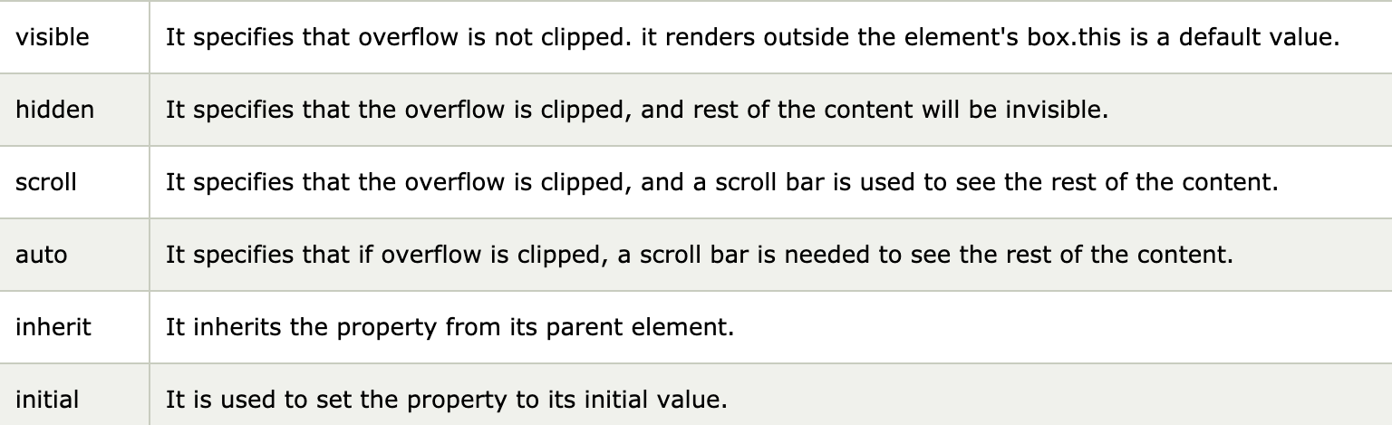
Overflow
It specifies how to handle the content when it overflows its block level container
The overflow property specifies whether to clip the content or to add scrollbars when the content of an element is too big to fit in the specified area.

Slide 37
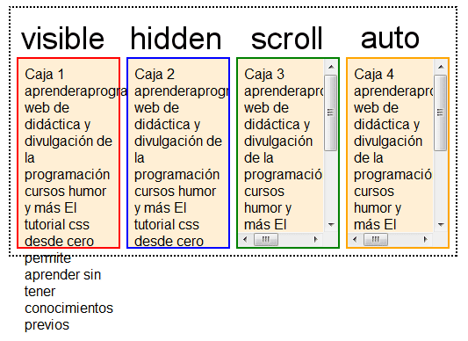
Overflow - Continue

Slide 38
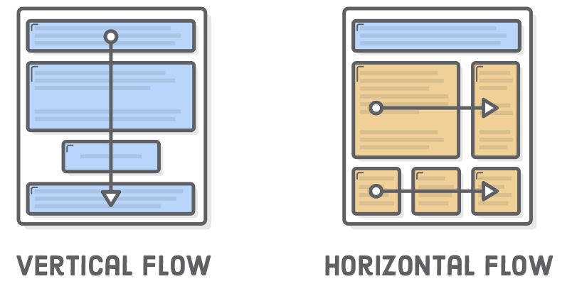
Float
The CSS float property is a positioning property.
It is used to push an element to the left or right, allowing other element to wrap around it.
It is generally used with images and layouts.

Slide 39
How Float works?
Elements are floated only horizontally. So it is possible only to float elements left or right, not up or down.
A floated element may be moved as far to the left or the right as possible. Simply, it means that a floated element can display at extreme left or extreme right.
The elements after the floating element will flow around it.
The elements before the floating element will not be affected.
If the image floated to the right, the texts flow around it, to the left and if the image floated to the left, the text flows around it, to the right.

Slide 40
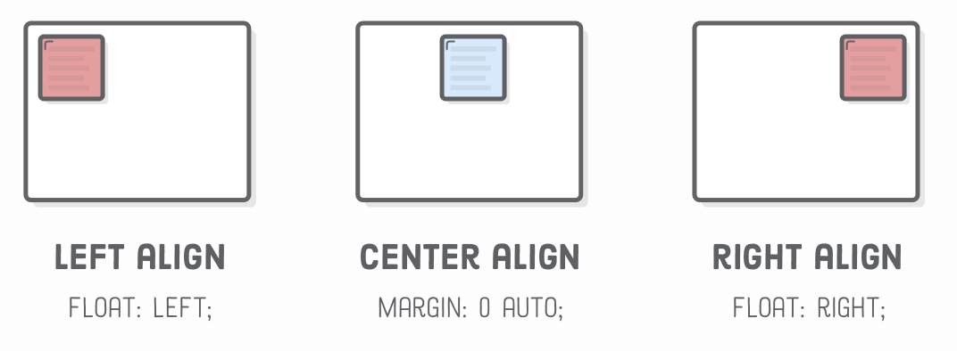
Float - Continue

Slide 41
Responsive Web Design
Responsive web design makes your web page look good on all devices.
Web pages can be viewed using many different devices: desktops, tablets, and phones. Your web page should look good, and be easy to use, regardless of the device.

Slide 42

Responsive Web Design

Slide 43
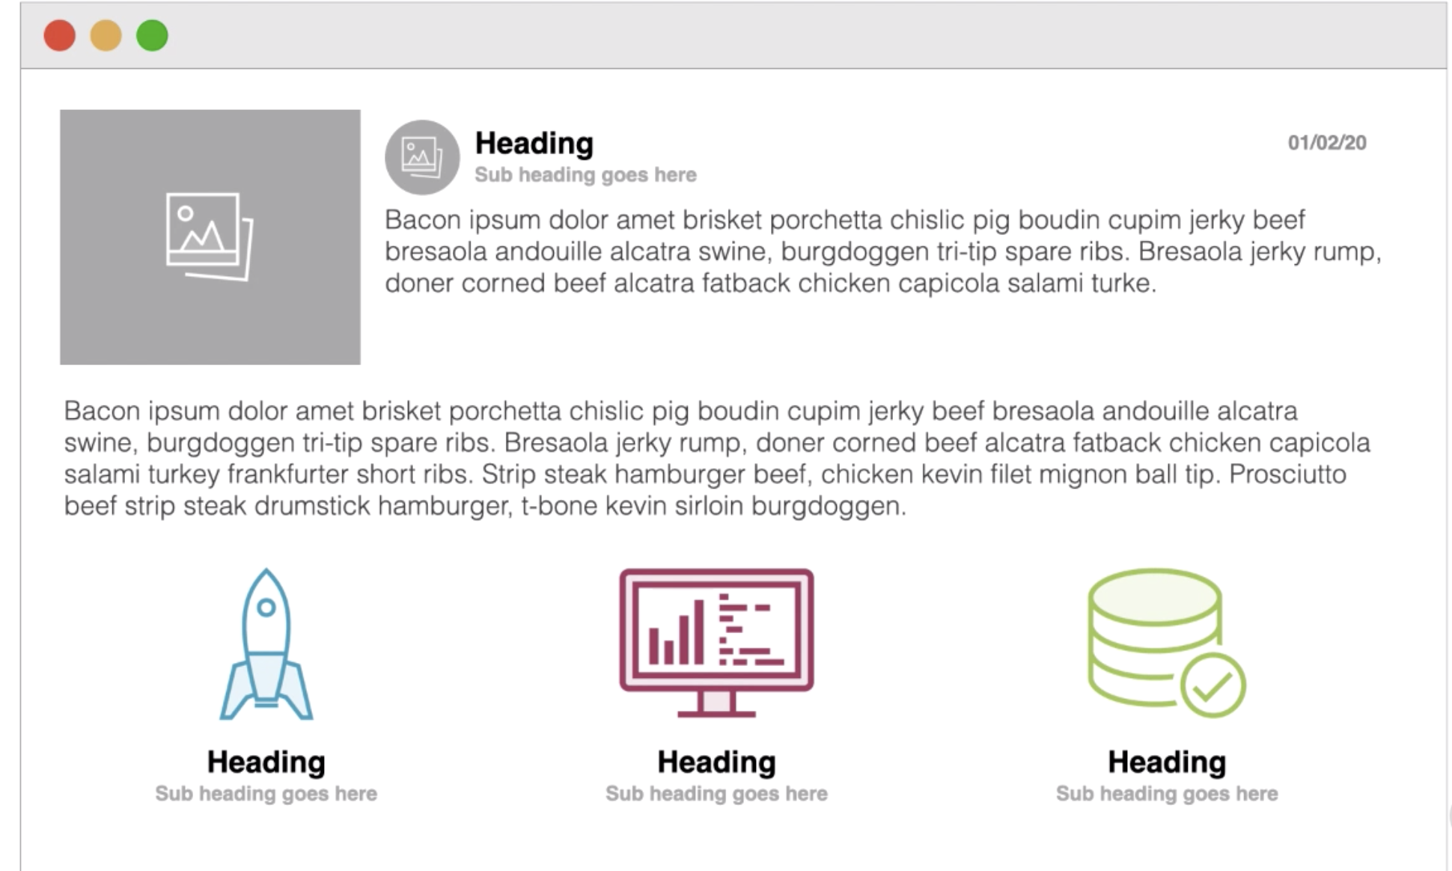

Slide 44
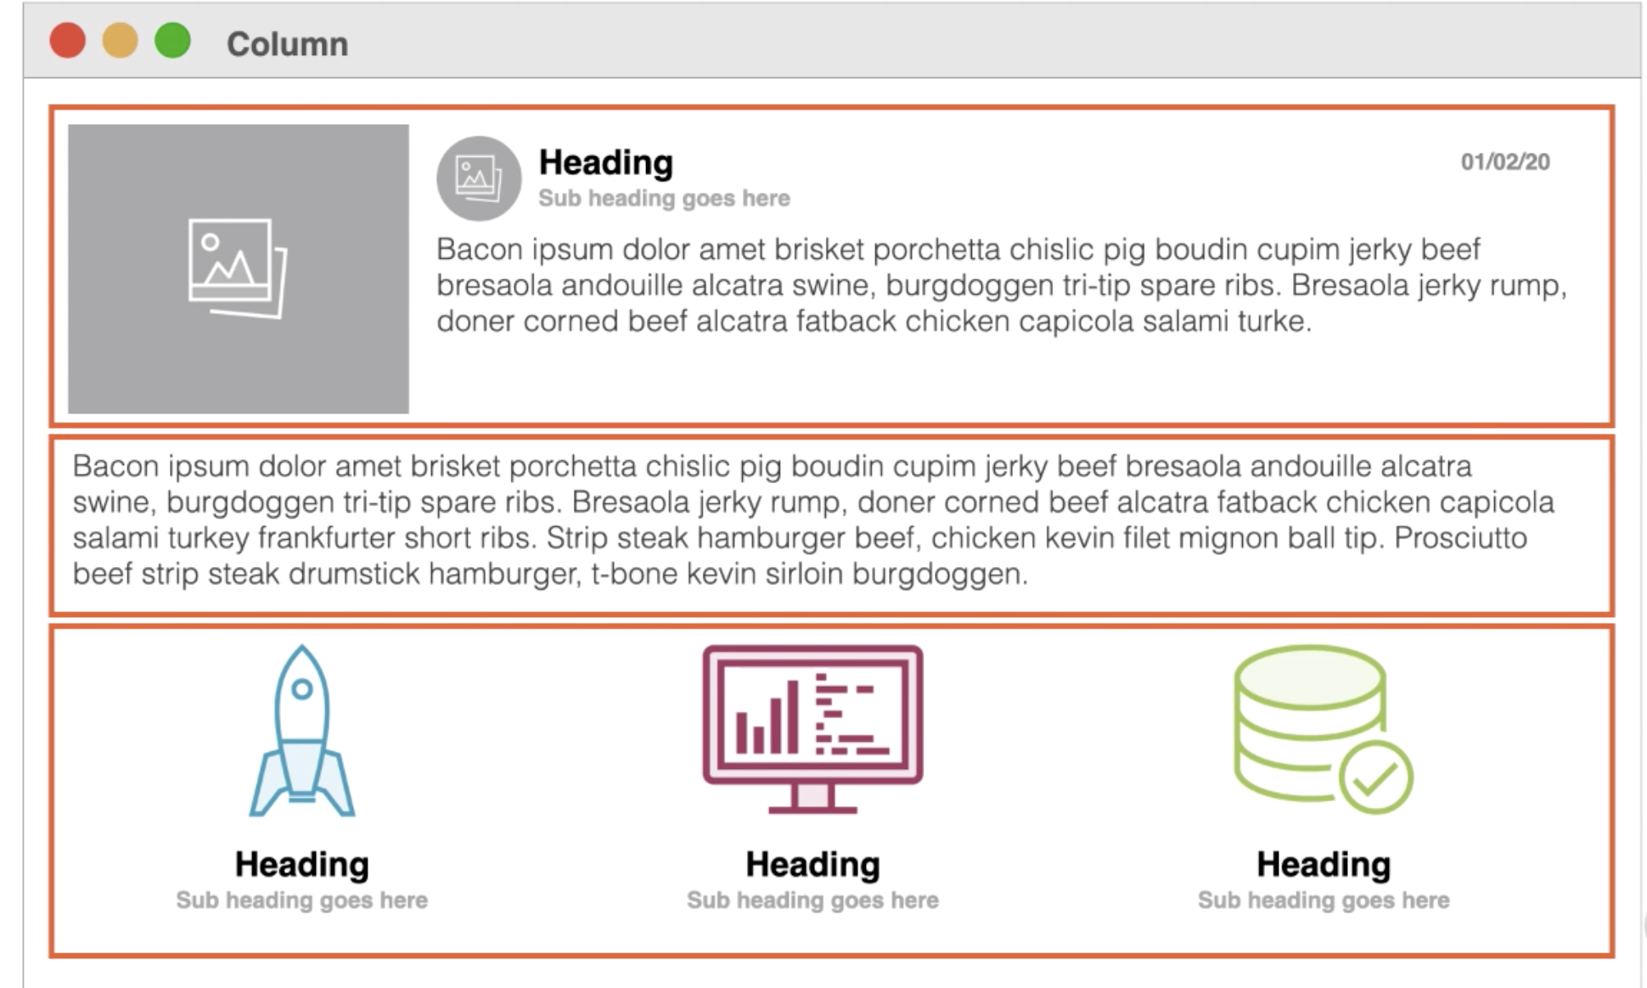

Slide 45
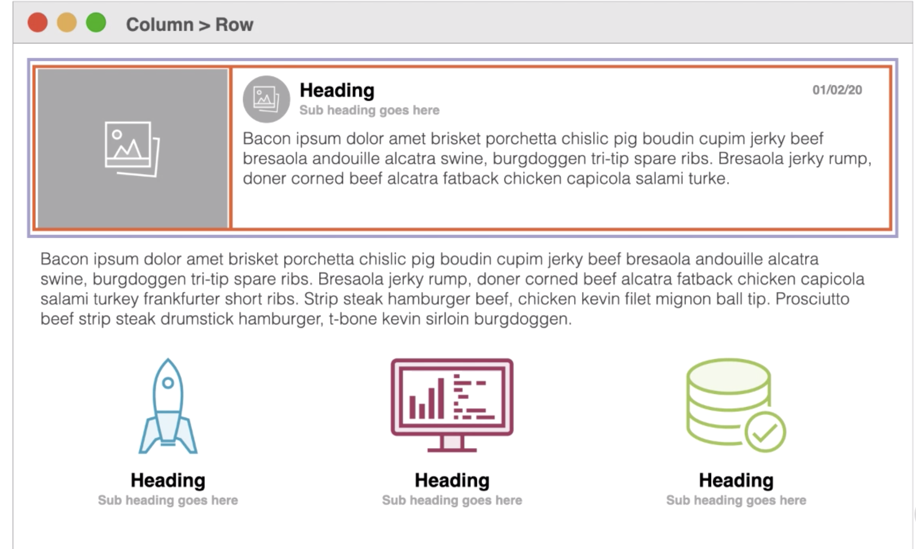

Slide 46
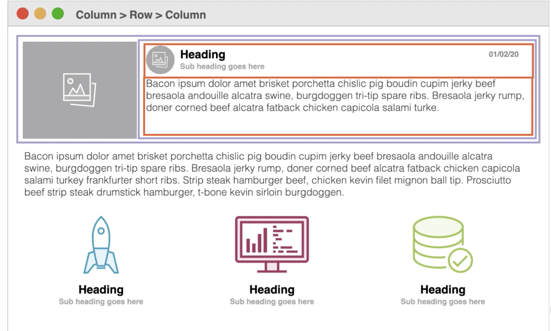

Slide 47
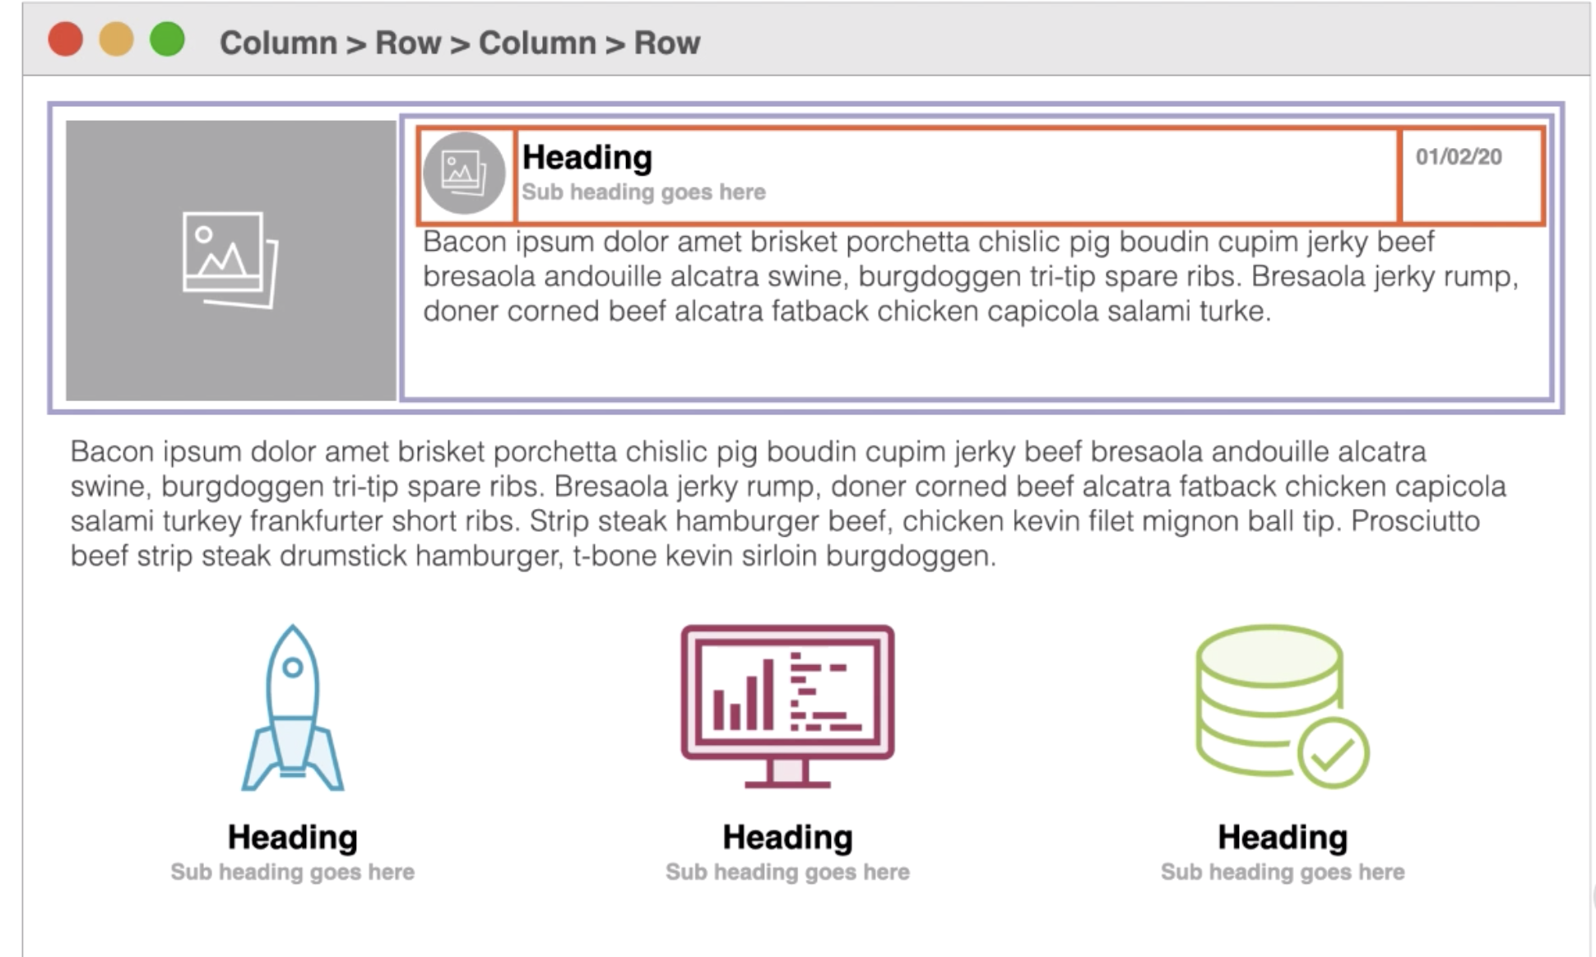

Slide 48
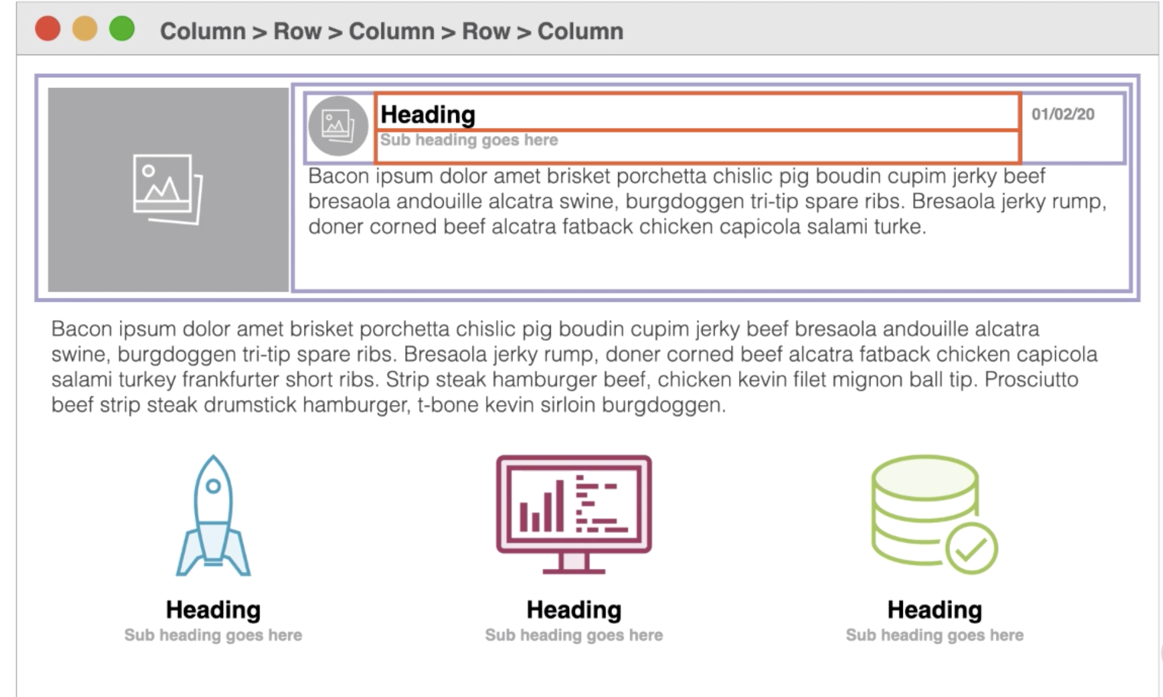

Slide 49
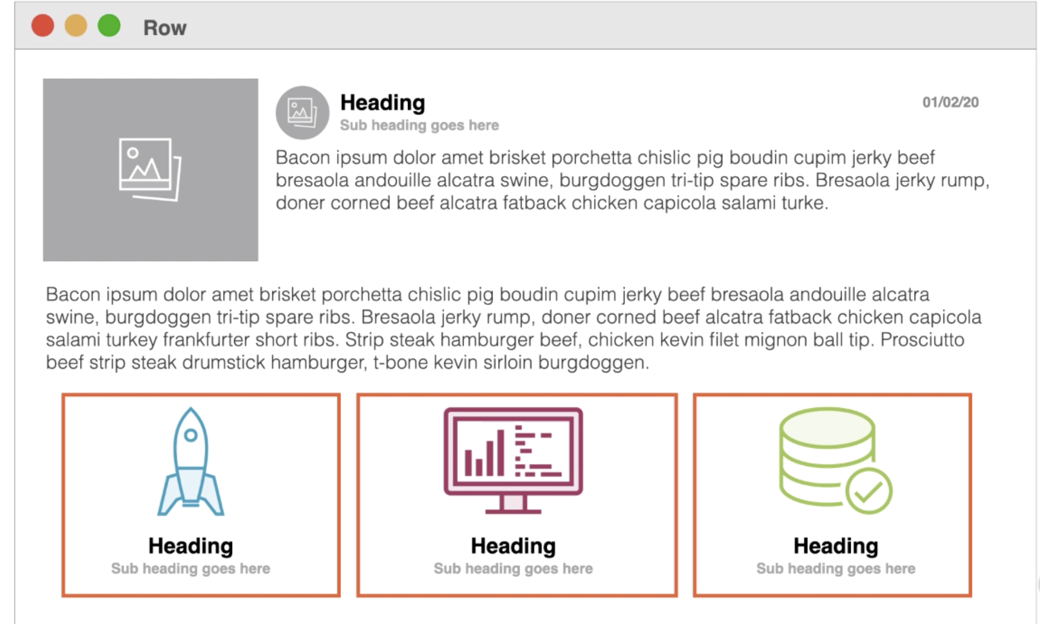

Slide 50
